Slide 1
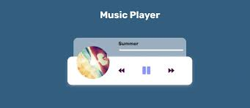
MUSIC PLAYER
SHAHEER ASAF 2024574
FATIMA KHALIL 2024176
SHANZEH SIDDIQUI 2024580

Slide 2

INTRODUCTION
For the Semester project of CS-101, Our Group decided and went on to design a code integrating all that we have learned throughout the semester, A UI which enables the user to playback music. This code allows the user to chose what song to play, to pause or play the song, to rewind or forward the song, or to skip it, Allowing a very easy and smooth experience of music playback the following snippets are each part of the code explained in detail:

Slide 3
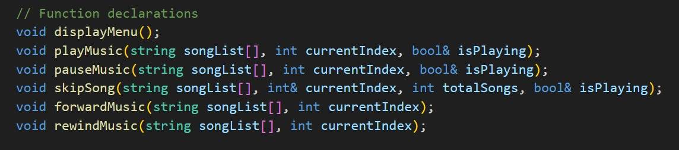
EXPLANATION PART 1: In this part of the code we declared the said functions, which define the names, return types and parameters for several functions related to controlling music playback. For instance the purpose of "void displayMenu" is to display a menu to the user giving options such as play, pause, skip, etc. Secondly the "void playMusic" holds the list of the songs, which is represented as strings and so on each function is declared for the said task.

Slide 4
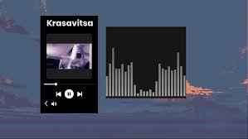

Slide 5
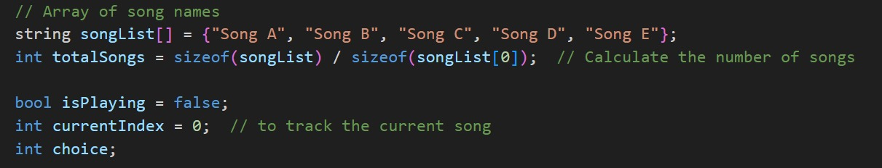
PART 2: This part of the code sets up and initializes some variables that will be used in the music playback program. "songList[]": Holds a list of song names."totalSongs": Calculates how many songs are in the "songList" array."isPlaying": Tracks whether music is currently playing."currentIndex": Tracks the index of the current song in the "songList"."choice": Will store the user's menu selection.These variables form the foundation for controlling the music playback and interacting with the user

Slide 6
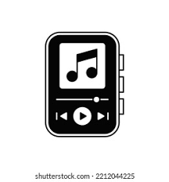

Slide 7
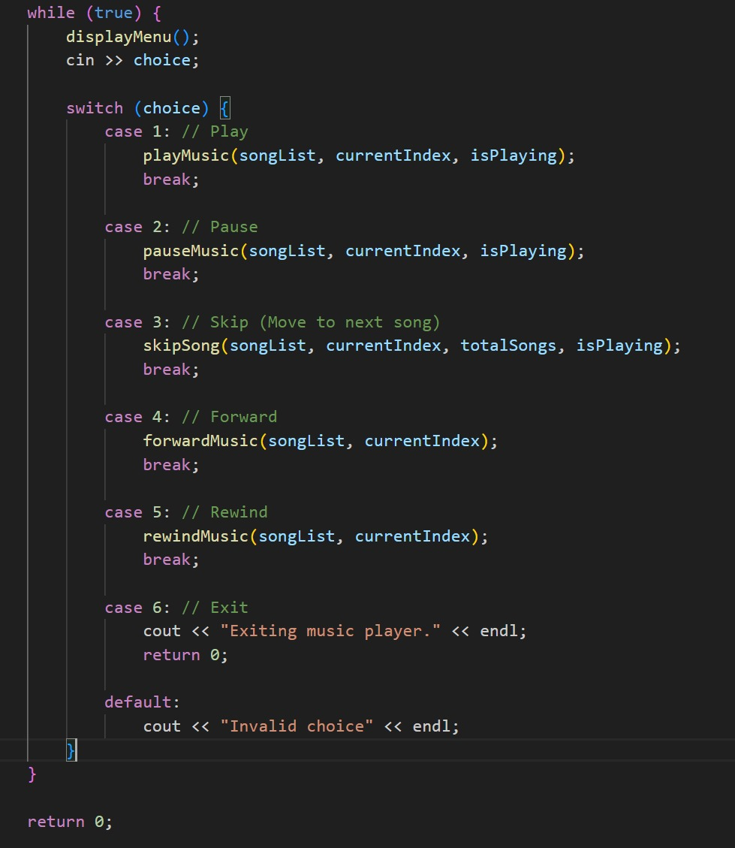
PART 3:
This part of the code represents a main loop that provides an interactive music player interface, allowing the user to control music playback through various options like playing, pausing, skipping, forwarding, and rewinding songs. The loop keeps running until the user chooses to exit the program.

Slide 8
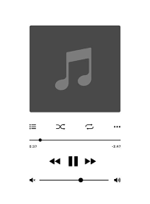


Slide 9
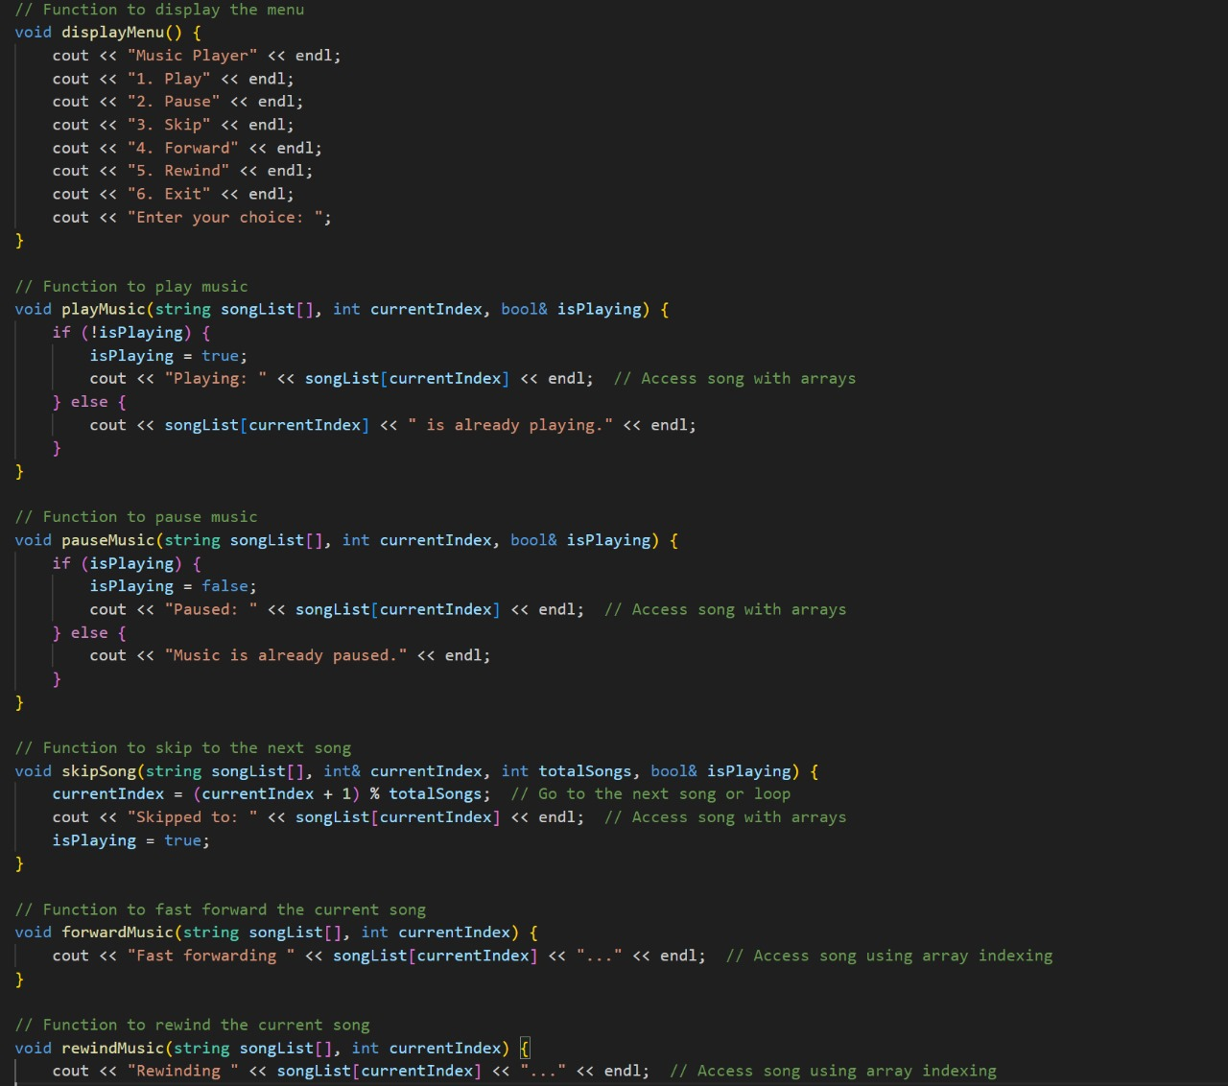
PART 4:
This part of the code defines the functions that control the behavior of the music player, including playing, pausing, skipping, forwarding, and rewinding songs. Each function is responsible for a specific action and operates on the music list (songList[]), the current song (currentIndex), and the playback state (isPlaying).

Slide 10
PART 4 CONTINUED:
"displayMenu()": Displays the available options for the user to control the music player.
"playMusic()": Starts playing the current song or informs the user if it's already playing.
"pauseMusic()": Pauses the music if it's playing or informs the user if it's already paused.
"skipSong()": Skips to the next song in the playlist, and wraps around to the first song if at the end.
"forwardMusic()": Simulates fast-forwarding the current song.
"rewindMusic()": Simulates rewinding the current song. Each of these functions is designed to interact with the song list, the current song index, and the playback state (isPlaying) to control the flow of music in the program.

Slide 11
THANKYOU

